Slide 1
Ensure Complex System Stability with Prompt Chaining
Module 3
Notes:
Module 3: Ensure Complex System Stability with Prompt Chaining

Slide 2

Class Expectations
Cameras On
Be present and visible with your camera on to stay engaged in class.
Arrive On Time
Respect everyone’s time by arriving promptly to sessions.
Engage to Network
Participate in labs and discussions to build your professional learning network.
📹
⏰
🤝
Tool Readiness
Any tools and accounts must be active before class; we will not stop or restart for setup.
Use Slack
Use Slack for all communication to keep questions and comments organized.
Class Momentum
Individual or deep-dive questions will be moved to after-class support.
🛠️
🎓
Notes:
Notes
📌Note for instructors: Please do not share the link to the slide deck with students. If they want to view the deck, send them to the LMS where they can view it from there.
Where to access content? You can view the deck from Docebo.
ℹ️ All students should have access to the LMS (Docebo) with all the class materials by now. If not, please reach out to Student Success directly in Slack.

Slide 3
Vibe Coding Syllabus
Execute Vibe Coding Velocity
Experience the build-and-learn cycle in one session. Create a functional prototype from an ambiguous problem to generate immediate evidence and apply the confidence line framework to prove you can build at lightspeed.
Validate Product Hypotheses via Risk-Based Prototyping
Map assumptions and apply a validation lens before opening the toolkit. Inject data, metrics, and specific hypotheses to construct prototypes that answer the why and ensure you are solving the right problem.
Ensure Complex System Stability with Prompt Chaining
Master context layering and constraint grounding to orchestrate multi-screen architectures. Use prompt chaining to maintain high-fidelity consistency and prevent system breakage as complexity scales.
MODULE 1
MODULE 2
MODULE 3
Transition From Prototypes to Production Specs
Enforce technical rigor by converting your build into version-controlled GitHub repositories. Formalize your logic and bridge the gap between vision and execution to command the engineering handoff.
Ship Live Products with Full-Stack Logic
Connect your build to live databases and secure APIs to move beyond the interface. Navigate system logic and edge cases to transform standalone features into integrated, production-ready products on a live URL.
Measure Product Performance for AI-Driven Iteration
Analyze real-world interactions against your hypothesis to evaluate performance. Use AI-driven analytics to identify friction and redeploy an improved update to secure the confidence line.
MODULE 4
MODULE 5
MODULE 6
Notes:
Vibe Coding Certification Syllabus
Build end-to-end applications faster—without a technical background.

Slide 4
Agenda
01 How to Prove Your Prototype is Resilient
02 A PM’s Precision Prompting Toolkit
03 Hands-On Lab: Execute Your Prompt Chain and Extend Your Build
Notes:
Agenda
How to Prove Your Prototype is Resilient
A PM’s Precision Prompting Toolkit
Hands-On Lab: Execute Your Prompt Chain and Extend Your Build

Slide 5
How to Prove Your Prototype is Resilient
Notes:
01. How to Prove Your Prototype is Resilient

Slide 6

Instructor-Led Demo
The Precision Prompt Chain
THE PROBLEM:
Your prototype has real data, real user quotes, a design reference, and a real hypothesis. But, what happens when your VP and they ask, “Where’s the full flow? What happens when things go wrong?”
You need to prove you could ship this tomorrow.
Notes:
Notes
💥Activity: Instructor-Led Demo
✏️Task: The Precision Prompt Chain
⏱️Time: 15 Minutes 📌 Note for Instructors: This is an Instructor-Led Demo. Students are not expected to build along with you. For more details, access our Demo Guide This is a demo designed to move the prototype to a resilient, multi-screen system. Your goal is to show that a prototype becomes a professional tool only when it handles the unhappy path and maintains architectural logic. Focus on the cumulative power of the three prompts—steering the build rather than restarting it.
CRITICAL: You must have your Module 2 Retention Engine prototype open.
You should also have your three prompts for your Prompt Chain pre-filled in from the Prompt Chain Planner tool.
Have a few additional visual references of screens from Asana ready to attach to your first prompt.
Also ensure you have practiced and run through this exercise at least once before your class so you are prepared.
Preparation & Setup
Open your Lovable project in a new browser tab.
Have the Prompt Chain Planner in a second tab, pre-filled.
Have your screenshots for the “Expand” prompt ready
Live Demo Steps
Explain that in Module 2, you built proof of concept, but it was fragile. It lacked depth and breaks the moment a user hits an edge case.
Today, the goal is to move to a multi-screen , resilient system using a three-step prompt chain.
4 MINUTES: Prompt 1: Expand (The Architecture Logic)
Copy the "Expand" prompt from the Planner. Attach the Asana and Intercom screenshots and press send.
Prompt: “Add a 4th screen: after the user invites teammates, show a team workspace with shared tasks and a "Your team is set up" confirmation — match the attached Asana team view screenshot. Add a 5th screen: an internal PM dashboard showing Day-3 invite rate, retention with vs. without invite, and churn trend — match the attached Intercom reporting dashboard screenshot. Navigation between all 5 screens.”
Point out
4 MINUTES: Prompt 2 — Behavior (The Constraint Grounding)
Copy the "Behavior" prompt from the Planner.
Prompt: "Add loading skeletons for the onboarding flow. Error state for failed invites: 'Couldn't send invite — check the email.' Empty state for the team workspace: 'Waiting for teammates to join.' Same design language throughout."
Ensure you mention that this is how to close the Fragility Gap. By hard-coding loading skeletons and error messages, you transform a static mockup into a piece of software that anticipates failure just like a production-ready product.
4 MINUTES: Prompt 3 — Refine (The Surgical Steer)
Copy the "Refine" prompt from the Planner.
Prompt: Focus only on the PM dashboard. Start by listing the 3 biggest gaps in the actionability of this screen compared to a professional analytics tool. Once identified, add a 'Send nudge email' button next to at-risk accounts and make the churn trend chart show a weekly breakdown on hover. Don't change anything else."
Point out you are forcing the AI to audit its own work first. By asking it to list the gaps before it touches the code, you prevent 'prompt drift and steer a specific element without risking the logic you built in the first two steps.
Close the demo with this main takeaway: In under 15 minutes, you have moved from a "happy path" mockup to a resilient, multi-screen system. You are architecting logic that handles failure and scales through precision and you have a documented, reproducible chain. Let students know that coming up next, they will be doing the same for their own projects.

Slide 7
Instructor-Led Q&A
Discuss the following questions
Open up your prototype from Module 2 and take a deeper look.
How many screens does it have? Can you navigate between them?
What happens while data is loading? What if there’s an error or no data?
If you had to pass this to a teammate today, could they reproduce this exact result using your current prompt?
Q&A DISCUSSION
5 minutes
Reflection Moment
Feel free to unmute and share, or post your thoughts in the chat!
To get you started thinking about what is missing from your Module 2 prototype, share your perspective on:
Notes:
Notes
💥Activity: Instructor-Led Q&A
💬Topic: Reflection Moment
⏱️Time: 5 Minutes
📌 Note for instructors: Keep this to quick answers from 2–3 volunteers. Stress there is no wrong answers, but highlight the uncanny valley of their M2 builds. They have the right data now, they should feel that the experience still lacks the polish and depth of a real product. The goal is for them to realize that a great hypothesis isn't enough if the execution breaks under pressure.
Instructions: To get students thinking about the gaps in their Module 2 prototype, ask them to open their M2 build and share their perspective on:
Questions:
How many screens does it have? Can you navigate between them?
If a user clicks past your primary flow, where do they end up?
What happens while data is loading? What if there’s an error or no data?
Is there an error state, or does the logic just break?
If you had to pass this to a teammate today, could they reproduce this exact result using your current prompt?
Could a colleague replicate your success, or is this a one-shot lucky roll that only exists in this chat?
You can frame it in a different way as a quick vote if students are not quick to respond. Ask:
By a show of hands, who…
…Has more than 3-4 connected screens? (Maybe a few hands)
…Has built out loading states or empty states for when there is no data? (Almost no one)
…Feels their current prompt is reproducible and documented for their team? (Likely silence)
Takeaway:
Let students know they feel that gap between their M2 build and a real app. Module 2 worked because it proved you can inject strategy and data. But as PMs, you know that "real" products require depth—loading states, error handling, and a full navigable experience. Today, they’re going to close that final gap, moving from a three-screen "test" to a reproducible, multi-state prototype that is actually ready for a stakeholder demo.

Slide 8
A PM’s Precision Prompting Toolkit
Notes:
02. A PM’s Precision Prompting Toolkit

Slide 9



The Prompting Maturity Curve
Exploration Prompts: Open-ended and flexible. Define the “what” through layouts and workflow. You provide the problem and AI suggests the best interaction pattern.
Execution Prompts: Rigid and constrained. Define the “how” through system-grade logic and depth. You dictate exact business rules and edge cases to ensure a professional, reliable demo.
Connecting Precision with Confidence
Your prompt style should match your confidence level. As you learn more about what you're building, your prompts must get more specific.
CERTAINTY
UNCERTAINTY
PRECISION
EXPLORATION
EXECUTION
Notes:
Notes Your maturity as a builder is measured by how much guesswork you leave for the AI as your product certainty grows.
Exploration Prompts: This is what you have mostly been doing throughout Module 1 and Module 2. You were using the AI like a flashlight, letting it suggest layouts and workflows while you were still hunting for the "what."
Execution Prompts: Today, that shift happens. You are moving into the blueprint phase where you've moved into the "how." As PMs, you are now the system designers, removing the AI’s creative license to ensure the build follows your exact business rules.
Vagueness is a bug. Your goal is to move away from the conversational vibing of previous sessions and toward rigid, system-grade instructions that leave zero room for hallucinations. By the end of today, your prompts should look like technical specifications.

Slide 10




Three Common Prompting Traps
The "Mega Prompt"
The “Vague” Request
The “Micromanager”
Don't try to build a database, API, and UI in one massive prompt.
Use prompt chaining to build logic first, then apply the design, so if something fails, you know exactly where.
Asking for a feature without defining the user state creates hollow shells.
Define the functionality and the specific user path before you hit enter to avoid hallucinated flows.
Wasting credits on text-based pixel tweaks is inefficient and confusing for the AI.
Use multimodal prompting to upload a screenshot of the exact style you want, forcing the AI to match it instantly.
Notes:
Notes
Before we dive into the solution, let’s look at the three traps that trip up even experienced PMs
The Mega Prompt. The trap is trying to do everything at once. When you ask for the database logic, the user flow, and the button animations in one massive prompt, the AI has to split its attention. If the build fails, you don't know which part of the prompt caused the collapse. The fix is Chaining. Build the bones of the logic first. Once that is stable, then apply the skin of the design
The Vague Request. The trap is vagueness. If you ask for a "Dashboard," you get a generic rectangle. Asking for a feature without defining the user state or the business rules creates hollow shells that break the moment a user clicks something unexpected. The fix is Intentionality. Never prompt without defining the specific functionality and the path you want the user to take.
The Micromanager. The trap is arguing with the AI about hex codes or padding values in text. It burns through time and usually results in the AI drifting away from the core logic. The fix is Multimodal. Don't describe the blue; show the blue. Upload a screenshot of your design system or a reference product and let the AI do the visual translation work for you so you can stay focused on the strategy.

Slide 11
✍️
Get a full list of prompting techniques you can try with our template
Prompt Chaining
The Execution Toolkit
Chain-of-Thought (COT) Prompting
How: Sequential Multi-Screen Building Force the AI to build in a strict, dependent order (Screen A > B > C). Use visual references for every new screen to anchor the layout while the prompt anchors the logic.
Step 1: Expand Build the Logic
Constraint Grounding
How: Constraint Injection Hard-code if/then triggers for the unhappy path. Ground the AI in specific rules for loading, empty, and error states so it behaves like real software, not a static mockup.
Step 2: Behavior Define the Flow
“The Brand Police” RAG
Reflection Prompting
How: Surgical Steering Isolate a specific screen and force the AI to audit the UI and list gaps before editing. This ensures precision and prevents it from restarting or changing your core logic.
Step 3: Refine Polish the Design
TAKEAWAY: You aren't just splitting one big prompt into three parts—you are layering different cognitive strategies in sequence so precision accumulates without breaking the foundation.
Notes:
Notes
📌 Note for instructors: Let students know there is a full prompting template with multiple prompt engineering strategies so students can try on their own outside of class.
We’ve established that Mega-Prompts are the enemy of precision. To build professional-grade products, we use the Execution Toolkit—a three-step chain where each step uses a different AI strategy to protect your architecture. The execution toolkit allows you to move from asking the AI for a mockup to orchestrating a professional system. Let's double-click into the specific prompting strategies you use to execute each one successfully.
Step 1: Expand — Chain-of-Thought (COT) Prompting: If you ask the AI to build the data structure, the user flow, and the UI all at once, it will compromise on all of them.
The Strategy: You use Chain-of-Thought to orchestrate sequential, multi-screen building. You force the AI to think in a strict, dependent order (A → B → C). Notice the addition of visual Anchoring. You are using visual references for every new screen to anchor the layout while your prompt anchors the logic. By building this way, the logic of the first screen becomes a mandatory anchor for the next, ensuring the system stays cohesive as it grows. By building this way, the logic of the first screen becomes a mandatory "anchor" for the next, ensuring the entire system stays hard-wired together as it grows.
Step 2: Behavior — Constraint Grounding: Once the architecture is there, you have to define how it acts. This is how you stop the AI from guessing how your business works or using generic, industry patterns.
The Strategy: You use Constraint Grounding for constraint injection. You are hard-coding if/then triggers for the unhappy path, ensuring you take into account the parts of the app most people forget to design. You ground the AI in specific rules for loading, empty, and error states, which ensures the prototype behaves like real, production-ready software rather than a static, fragile mockup.
Step 3: Refine — Reflection Prompting: Finally, you polish the surface. This is where you avoid the "micromanager trap" of constant re-prompting.
The Strategy: You use reflection prompting for surgical-level steering. Instead of just asking for a change, you isolate a specific screen and force the AI to audit the UI and list gaps before it touches a single line of code. This "think-before-you-do" flow ensures extreme precision. By making the AI identify the flaws first, you prevent it from "restarting" the project or accidentally changing your core logic while trying to fix a button.
This toolkit ensures that every layer of the product is intentional and, more importantly, reproducible for team handoff.

Slide 12
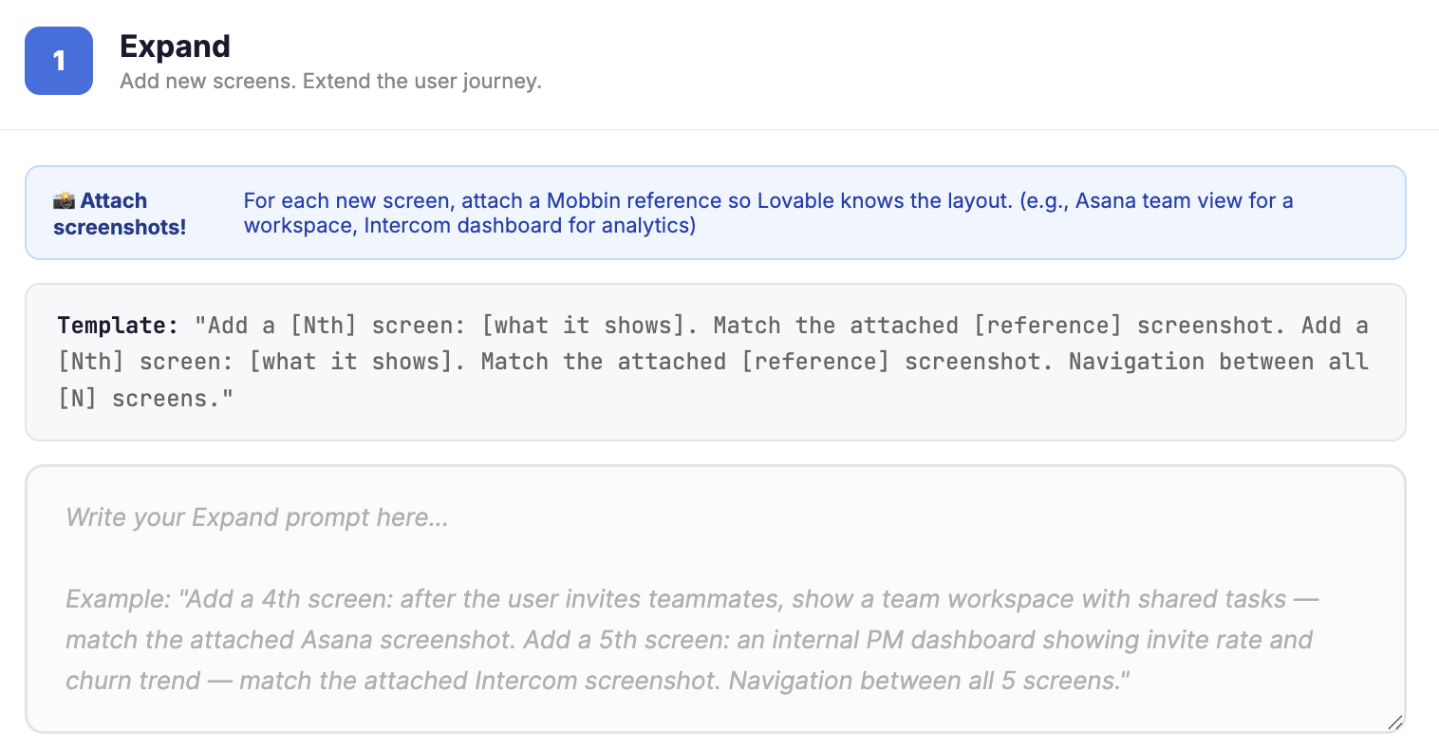
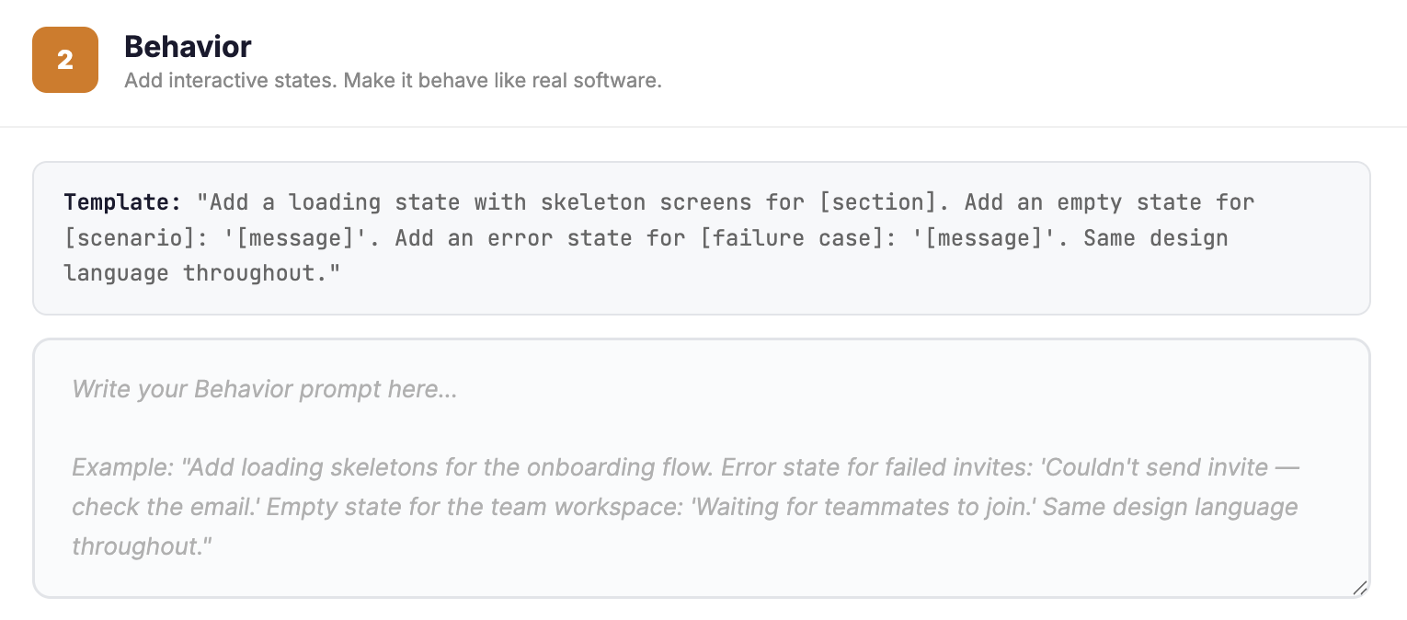
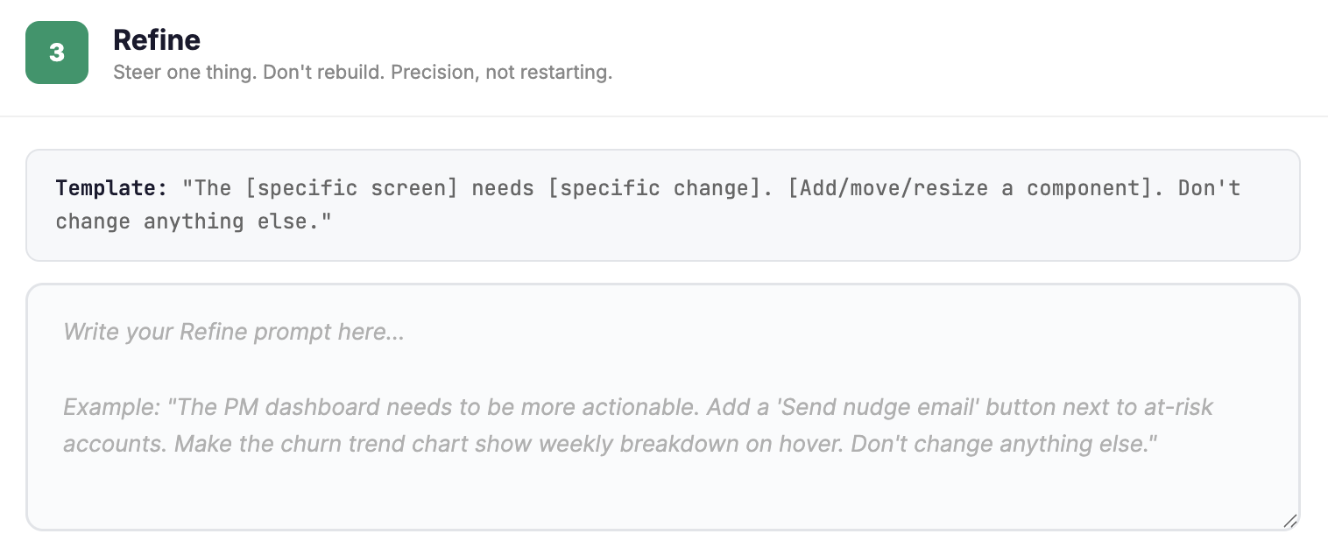
Prompt Chaining in Action
“Build the next phase of this app in a strict sequence: 1. Add a 2nd screen: 'User Settings'. Match the layout and spacing of the attached Asana reference. 2. Add a 3rd screen: 'Account Activity'. Match the data-heavy density of the attached Intercom reference. 3. Navigation: Write the logic so 'User Settings' links to 'Account Activity'. Build these in order so the Settings screen serves as the mandatory anchor for the Activity view.”
1
Expand: COT Prompt
"Apply the following logic constraints to the 'Account Activity' flow: - Use skeleton screens for the transaction list loading state. If no data is present, show the empty state message: 'No activity yet. Start your first project to see data here.' - In the event of a fetch failure, trigger the error state: 'Connection lost. Please refresh the dashboard. Maintain the same design language throughout and tether all behavior strictly to these rules."
2
Behavior: Constraint Grounding
3
Refine: Reflection Prompt
"The User Settings screen needs a professional Asana-style polish. Start by listing the 3 biggest gaps in typography and spacing compared to the Asana design system. Once you've identified those, resize the headers and update the primary button hex code to match that standard.Don't change anything else in the project or touch the underlying logic."
Notes:
Notes
Now let's see a prompt chain in action, which adds precision with context and prompt engineering.
Step 1: Expand (Sequential Logic): Here is what Visual Anchoring looks like in a real prompt. Notice that we aren't just describing a settings page; we are tethering it to a specific visual North Star—the Asana reference. By explicitly labeling the screens as 2nd and 3rd, you’re forcing the AI into that Sequential Building mindset we just discussed through chain-of-thought. It can’t just guess the layout; it has to look at the image for the "where" and the prompt for the "how." You’re ensuring the Settings screen serves as the structural anchor for everything that follows, making the navigation logic mandatory rather than optional.
Behavior: The Flow Definition: Now, look at how we move into Logic Injection. We’ve shifted from building screens to hard-coding the "Un-Happy Path." This is Constraint Grounding in practice. We aren't asking the AI to "make it look like it's loading"—we are telling it to use skeleton screens and giving it the exact strings for empty and error states. By "tethering all behavior strictly to these rules," you are creating a predictable environment. This is where you stop the AI from hallucinating behavior and start making it act like professional-grade software.
Step 3: The Surgical Polish: Finally, we get to the Reflection Prompt. This is how you actually execute Surgical Steering. Notice the prompt doesn't start with "fix the font." It starts by forcing the AI to audit and list the gaps first. This creates the "Think-then-Do" bridge. By identifying the 3 biggest typography gaps before touching the code, the AI is much more likely to be precise. The final guardrail—"Don't change anything else"—is your insurance policy. It protects the core logic you built in the previous two steps while you drive that final design polish home.ps do you allow it to execute the fix. This "Think-then-Do" flow ensures that your final edits are targeted strikes that reach that 95% professional polish while keeping your core foundation locked.
Now it’s your turn to apply this same precision to your prompting.

Slide 13
Individual Exercise
Steps to Follow:
Open your Module 2 prototype and audit its current architecture. Identify 3-5 flow gaps, 3 specific friction points, and 1 targeted UI element to refine.
Draft your three step chain using your own logic, or try the 🔗Prompt Chain Planner (if you get stuck!) to write your Expand, Behavior, and Refine prompts.
For the COT sequence, make sure you gather the screenshots or references you want to use to build your additional screens.
Ensure you copy and paste your finalized prompts into the corresponding section of the table in your exercise document for safe keeping. You’ll need them for peer review and the upcoming lab!
INSTRUCTIONS
15 minutes
Plan Your Prompt Chain
In this individual exercise, you will apply the execution toolkit to your project and map out your Expansion, Behavior, and Refinement prompts for your three-step prompt chain.
Your goal is to audit your existing screens to bridge the gaps in your flow, hard-code the unhappy path for error and loading states, and select a specific UI target for a surgical design polish.
Note: This is pre-work to lock in your system architecture. Do not open Lovable or begin building yet.
✍️ Complete your prompt chain in this activity here
Notes:
Notes
💥Activity: Individual Exercise
💬Topic: Plan Your Prompt Chain
⏱️Time: 15 Minutes
📌 Note for Instructors: Emphasize that this is planning before building. Students must not open Lovable yet. This exercise ensures their logic is locked in before they start touching their code.
Let students know they will join a random breakout group to work in a “co-working” environment, but they should each be building their own solution.
After a few minutes, pop into each group to see how students are getting on and check for:
Depth of logic
Gaps in assumptions
Remind students they must have their three prompts locked in and document by the end of the session to be ready for peer review and the upcoming Lab.
Scenario: In this individual exercise, students will apply the execution toolkit to their own projects to map out a three-step prompt chain. Their goal is to audit their existing Module 2 build screens to bridge flow gaps, hard-code the unhappy path for error states, and select a specific UI target for surgical refinement.
Instructions:
👉Share the link to the activity guide in the chat.
Tell students to open their Module 2 build and audit the current architecture. They must identify 3–5 flow gaps, 3 specific friction points (loading/error/empty), and 1 targeted UI element to refine.
Direct students to draft their three-step chain on their own with the help of an LLM (or they can use the Prompt Chain Planner if they are stuck). Ensure they are writing out the specific Expand, Behavior, and Refine prompts based on their audit.
Remind students to gather visual anchors for the COT sequence for the first prompt. They should have screenshots or references ready to guide the layout of any additional screens.
Confirm students copy and paste finalized prompts into the corresponding table in their exercise document. Explain that these are required for the upcoming peer review and lab.
➡️ Reminder to create Breakout Groups in Zoom

Slide 14
Breakout Group Exercise
After 3 minutes of silent reading discuss the following:
Did you notice a sudden jump or any confusion in the screen sequence, and if so, where?
Is there a specific piece of logic for error handling or loading states that might have been missed?
What is the strongest part of this chain that makes it reusable for other projects?
FEEDBACK DISCUSSION
10 minutes
Show and Swap Your Prompt
To reflect upon what you’ve built, pair up with a peer and let them cold-read your prompt logic. This mirrors professional hand-offs and proves whether your expansion and grounding strategy is a reusable system or or not.
Swap your Prompt Chain Plan (your three drafted prompts) in the chat.
Read your partner’s prompts silently for 3 minutes. Do not provide or receive any verbal context or explanations.
Notes:
Notes
💥Activity: Breakout Group Exercise
💬Topic: Show and Swap Your Prompt
⏱️Time: 10 Minutes
Instructions: To get students to reflect upon what they’ve built, randomly assign students into breakout rooms in groups of two. Instruct the pairs to exchange their three prompt chain copy in the chat immediately. Tell them this is a “logic stress test"—they must determine if their prompt sequence is clear enough for a human to follow without a verbal walkthrough.
Emphasize that for the first 3 minutes, one partner waits as the other reads. No explaining, no justifying. If a user gets confused, that is the data!.
Then, after 3 minutes, the partner reading answers the three questions on the slide/in the guide while the writer takes notes. Then, swap and repeat.
Questions:
Did you notice a sudden jump or any confusion in the screen sequence, and if so, where?
E.g., Did you understand exactly how the user gets from the first screen to the last, or was there a missing step?
Is there a specific piece of logic for error handling or loading states that might have been missed?
E.g., What happens if the data fails to load? Is there a "Constraint Grounding" rule for that scenario?
What is the strongest part of this chain that makes it reusable for other projects?
E.g., Which part of the prompt structure was so clear that it could be used for a completely different app or use case?
➡️ Reminder to create Breakout Groups in Zoom

Slide 15

Key Learning Statement
Quick Debrief
IN ONE SENTENCE:
What was the biggest logic gap your partner found in your prompt chain that you completely took for granted.
POST ON SLACK
Notes:
Notes
💥Activity: Quick Debrief
💬Topic: Key Learning Statement
⏱️Time: 2 Minutes
Instructions: Ask students to quickly jot down one sentence in your designated Slack cohort that answers the following: “What was the biggest logic gap your partner found in your prompt chain that you completely took for granted.” As the responses come in, read them aloud and comment on what are some similar key messages and learnings.
Focus on the power of logic anchoring. Explain that by having someone cold-read their prompts, they just performed a pre-flight check on their build. They validated their architectural logic before spending a single credit. Most developers waste hours to fix hallucinations that could have been prevented with a clear logic chain. They just identified their weakest links in 3 minutes rather than 3 hours of debugging!

Slide 16
Estimated time: 5 minutes
Notes:
Notes
Time for a 5-minute break—you’ve earned it! ☕

Slide 17





Reminder! 🚨
It's always better to see your smiling face! Be present and visible to stay engaged and keep interactions valuable.
Cameras On

Slide 18
Execute Your Prompt Chain and Extend Your Build
Hands-On Lab
Notes:
03. Hands-On Lab: Execute Your Prompt Chain and Extend Your Build

Slide 19
Individual Exercise
Steps to follow:
Open your Module 2 prototype in 🔗 Lovable.
Execute Prompt 1: Expand. Copy your prompt from the Planner, attach your references, and build your new screens. Fix any layout issues, then document what was produced.
Execute Prompt 2: Behavior. Paste your logic for loading, error, and empty states. Verify one "unhappy path" works in the prototype, then record the result in your Planner.
Execute Prompt 3: Refine. Use surgical steering to polish one specific element. Check that the change is localized, then document the final output in your Planner.
Finalize your Prompt Chain Planner and ensure all "What did this produce?" sections are filled. This becomes the raw data for your final Living Prompt Pack.
LAB EXERCISE
30 minutes
Execute Your Prompt Chain and Extend Your Build
In this hands-on lab, you’ll return to your M2 prototype and systematically deploy your three-step prompt chain to evolve your core screens into a comprehensive, multi-state system.
Your goal is to execute your Expansion, Behavior, and Refinement prompts one by one.
Keep in mind: You must record the result of every prompt in your planner to finalize your Prompt Library - an essential deliverable for your final project.
✍️ Return to your exercise guide from earlier to complete this lab.
Notes:
Notes
💥Activity: Individual Exercise
✏️Task: Execute Your Prompt Chain and Extend Your Build
⏱️Time: 30 Minutes
📌 Note for Instructors: This is about production volume and velocity. The goal is for students to realize that with a precision chain, they can build more in 30 minutes than most teams build in a month. Encourage them to push past the "minimum" and see how much functional depth they can actually reach. The goal isn't just to "finish the three prompts," but to use that chain as a launchpad for a production-ready system.
While students are working independently, create breakout rooms to simulate a "coworking" environment where they can build in the presence of others, network, and support each other.
CRITICAL: Remind students that they should not settle for one new screen; they should be pushing to complete the entire multi-state journey.
Key things to watch out for:
Monitor for students who treat the three prompts as a "to-do list" and stop once they hit Prompt 3. Push them to restart the cycle: "Now that the logic is there, what’s the next feature to Expand? What’s the next Behavior to ground?"
Ensure they are actually using the Do-Document-Fix loop. If they skip the documentation, they won't have the "receipts" needed for their prompt library.
Scenario: In this hands-on lab, students will deploy their three-step chain and prove they can handle complex state management and multi-screen flows at high speed. Success is a prototype that feels like a finished product, supported by a documented logic chain..
IMPORTANT: 👉Remind students to return to their exercise guide from earlier and move to the Hands-On Lab section.
Instructions:
Instruct students to open Lovable and set a hard timer for 30 minutes.
Remind them of the sequence for each of the three prompts:
Execute: Paste your drafted prompt.
Document: Record the output in your Planner.
Fix: Ensure the result is stable and navigation works.
Move On: Only move to the next prompt in the chain once the previous one is "anchored."
Remind them that Prompt 3 (Refine) is their scalpel. Use it to tighten the UI so the final product looks like a finished app, not a rough draft.
If they finish the initial 3-prompt cycle, tell them to start again. Find the next "Flow Gap" and run a second chain to add even more depth.
Pop into breakout groups periodically to see how things are going.
➡️ Reminder to create Breakout Groups in Zoom

Slide 20
Prompt Functionality Statement
Quick Debrief
IN ONE SENTENCE:
What made your prompt work? Or, what didn’t and what did you change?
Then, reply to 2 other learning sentences from your peers.
POST ON SLACK
Notes:
Notes
💥Activity: Quick Debrief
💬Topic: Accountability Statement
⏱️Time: 2 Minutes
Instructions: Ask students to post their one-sentence learning in the Slack channel by answering “What is one thing they learned about their product idea that they didn’t know 60 minutes ago?” Once they've posted, have them read through the channel and reply to at least two of their peers' sentences. As the responses come in, read them aloud and comment on what are some similar key messages and learnings.
Stress that this isn't about "liking" a post; it's about acknowledging the insights others found.

Slide 21
“Break It” Mindset
Prompt Chain Debugging
When a prompt chain goes off-rails, diagnose before re-prompting. Throwing more prompts at a broken chain just compounds the error.
If you're 5+ prompts deep on the same issue, the problem isn't the tool — it's your framing.
WORK STEP BY STEP:
Read the Chain
01
Compare the Output
02
Diagnose
03
Fix It
04
Notes:
Notes
When you are in the middle of a build, it is tempting to think that the next prompt will be the one that finally fixes it. But throwing more prompts at a broken chain doesn't solve the problem. In fact, it compounds the error. As a Senior PM, you need to recognize that if you’re 5+ prompts deep on the same issue, the problem isn't the tool; it’s your framing. You need to stop rage prompting and move into a diagnostic mindset. When your chain goes off-rails, follow this sequence to regain control of your build:
Read the Chain: Go back and look at the actual text of your previous three prompts. Often, you’ll find that you gave the AI a "Never" rule in Prompt 1 that is now directly contradicting what you're asking for in Prompt 3.
Compare the Output: Look at the delta between what you asked for and what was produced. Is the AI failing because it doesn't understand the Logic, or because the Context is too cluttered?
Diagnose: Identify the specific point of failure. Did the AI ignore a constraint? Did it lose the thread of the design system? Isolate the one variable that is causing the drift.
Fix It: Once you’ve diagnosed the root cause, don't just keep going. Revert to the last stable state and re-prompt with a cleaner, more targeted instruction that addresses the specific framing error you identified.
The goal of this “break It" mindset is to realize that diagnostic time is not lost time. It is the only way to prevent a total build collapse. When you diagnose the framing before you re-prompt, you ensure your chain remains a precision tool rather than a pile of conflicting instructions.

Slide 22

Your Product Skill File
Living Prompt Packs
The Anatomy
Your Prompt Pack is a markdown asset that encodes your product's DNA into four reusable blocks:
Product Context: Your source of truth for every new session.
Design Reference: Visual DNA
Constraint Templates: "Always/Never" logic
Output Templates: Blueprints for components and navigation flows.
The ROI
Your Prompt Pack becomes a tool-agnostic asset that secures your product logic:
Cross-Tool Portability: Move between vibe coding tools without losing your core logic.
Guaranteed Reproducibility: Anyone can run your pack and get the exact same professional result.
Cumulative Precision: Every refined constraint becomes a permanent, reusable Skill.
TAKEAWAY
In Module 1, you learned that AI Skills exist—now, you are architecting them yourself. You no longer shop for solutions or wait for a marketplace; you drive the execution from scratch.
Notes:
Notes
So where so you store your work from your prompt chain? In a Living Prompt Pack. Think of it as a 'Skill File' you’ve built yourself that makes your product logic portable.
The Anatomy (The DNA): This pack encodes your product's DNA into a Markdown asset. It’s built on four pillars:
Product Context: This is your source of truth. Instead of re-explaining your product every time you open a new tab, you paste this block to instantly align the AI on your mission, user personas, and core value prop.
Design Reference: This is your visual DNA. Whether it's an company-style anchor, a Figma link, or specific CSS variables, this ensures the AI doesn't default to 'generic web style' but stays on-brand.
Constraint Templates: These are your 'Always/Never' rules. You’re hard-coding your standards like 'always use skeleton loaders' or 'never use pop-ups' so the AI doesn't have to guess how to handle edge cases.
Output Templates: These are your repeatable blueprints. Once you find a component or navigation flow that works, you turn it into a template so you can generate similar features in seconds rather than starting from a blank prompt.
The ROI (Precision at Scale): By securing your logic in a tool-agnostic format, you get:
Cross-Tool Portability: You aren't locked into one vendor. You can take your core logic from Lovable to Bolt or v0 without losing any of your product brain or starting from scratch.
Guaranteed Reproducibility: You’re eliminating the 'it worked for me but not for them' problem. Any stakeholder or teammate can pick up this pack, run the chain, and get the exact same 95% polish you achieved because the constraints are locked in.
Cumulative Precision: Stop solving the same problems twice. Every time you refine a prompt or fix a bug, you update the pack. It becomes a permanent, reusable Skill that gets smarter over time.
In Module 1, you learned that AI Skills existed in a marketplace. Now, you’re architecting them yourself. You don't need to shop for solutions or wait for someone else to build a tool; you're driving the execution from scratch. This is the vibe-coding mindset: you own the logic, and the Prompt Pack is how you deploy it.

Slide 23


What You Accomplished Today
MODULE 3 COMPLETE
The Operational Pivot — From Instinct to Architecture | Vibe Coding Certification
The Numbers
The Shifts
Stress-Test Review
3
Chained Prompts
You replaced the AI guessing with a 3-step sequence: Expand, Behavior, and Refine to scale your build.
The Fragility Gap: Hardened
You’ve eliminated happy path traps by mastering system states. By baking in loading skeletons and error handling, you’ve transformed a static mockup into a resilient machine that anticipates failure like a professional product.
1
You proved your intent was sharp enough for a peer to read and understand your logic without a walkthrough.
Peer Audit
Portable Assets: Secured
1
You’ve started a collection of high-performance prompt structures that will serve as the engine for any future project.
You’ve launched your living library. You now realize a prompt's value is the underlying framework, not project data. You have reusable skeletons that port into any future product challenge.
Living Library
📍 Project Deliverable Check: Copy your successful “gold standard” prompts from today into the Prompt Library and Logic on slide 8 of your final project deliverables deck today.
Next: Module 4 — Make the jump from prototype to production.
Notes:
Notes
📌 Note for instructor: Use this slide as a way to not only share today’s accomplishments but get students excited about what’s to come! This is the "landing the plane" moment where you shift their identity from someone who sends prompts and expect the AI to fill in the gaps to someone who knows exactly how to get the precision they need.
As we wrap up today, let’s look at the math of your new operating model. You’ve moved from guessing to sequential execution. In your day job, how often does a project stall because the happy path looked great in a design review, but the whole thing fell apart when you actually had to think about edge cases, error states, or loading logic? Usually, that’s a conversation that happens weeks too late with an engineer. But look at what you did today.
You closed the Fragility Gap by engineering a resilient machine that anticipates failure. You baked in loading skeletons and error handling from the start and moved past the "Vibe Ceiling" to build something that actually behaves like a shipped, professional product.
Most importantly, you have secured your portable assets. You’ve realized that the gold isn't any one specific screen you’ve built—it’s the Prompt Framework you used to get there. You now have a Living Library of reusable skeletons for Expansion, Behavior, and Refinement that you can port into any future product challenge, no matter the industry or the metric.
You have turned the AI into a partner that understands your architectural intent as well as you do.
Project Reminder: Take a moment today to copy your successful “gold standard” prompts into Slide 8 of your final project deck. That is your intellectual property—don't lose it. Coming up in Module 4, we are going to graduate this build. You've built fast, smart, and precise. Now, we’re going to make the jump from prototype to production. We’re going to extract a real PRD from your logic and refactor this code into a clean, maintainable architecture.

Slide 24
Key Takeaways
Ensure Complex System
Stability with Prompt Chaining
Product Managers must evolve from open-ended exploration to rigid, rule-bound execution as confidence grows. Prompts must shift from defining the “what” to dictating the exact “how” through system-grade logic and depth.
When a chain fails, PMs must stop rage prompting and diagnose the framing error before attempting a fix. If a build is five prompts deep on one issue, the problem is the underlying .
PMs master multi-screen builds by chaining Expand, Behavior, and Refine stages to anchor both layout and logic. Layering constraint injection transforms a static mockup into a functional system that handles real-world failure.
Notes:
Notes
At the end of each module, recap key concepts and content covered in today’s lesson.

Slide 25
Transition From Prototypes to Production Specs
Extra Practice
Optional: Dig deeper into your hands-on lab experiences and try these exercises on your own.
1. Execute a Partner’s Chain
Swap finalized prompt chains with a peer and attempt to build their project from scratch in a new Lovable tab. Does their logic hold up without extra prompts, or does the chain break when they aren't there to steer it?
2. The 10-Prompt Stress Test
Take your finished Module 3 build and try to add three more complex features using only surgical refinement. See how many layers of logic you can add before the foundation gap appears or the AI begins to lose track of your original system rules.
⏩ Next Session
Overview
Enforce technical rigor by converting functional builds into living specifications that bridge the gap between vision and engineering execution.
Formalize your product logic by extracting grounded specs, connecting real infrastructure like GitHub and Supabase, and generating professional handoff documentation.
Notes:
Notes
📌 Note: that the “Dig Deeper” section is optional for students who want to get additional practice with more advanced topics or explore further on their own time.
Next Session: Give a brief overview of what students can expect during the next session.

Slide 26

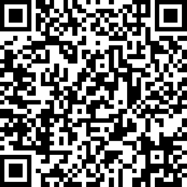
Share here
Your Opinion Matters To Us
Your Opinion Matters To Us
We’d love to hear about your experience!
At the end of each session, please scan the QR code or use the link to share your feedback.
Your insights help us improve and make each cohort better than the last.
🔗 Day 3 Survey Link
Notes:
Notes
We will be having daily surveys at the end of each class, and your opinion matters to us.
This is crucial in making sure our team can learn the best way to support you, and if we are also hitting the mark, Like real product managers, we would want to iterate and adjust so that we can support your needs.

Slide 27

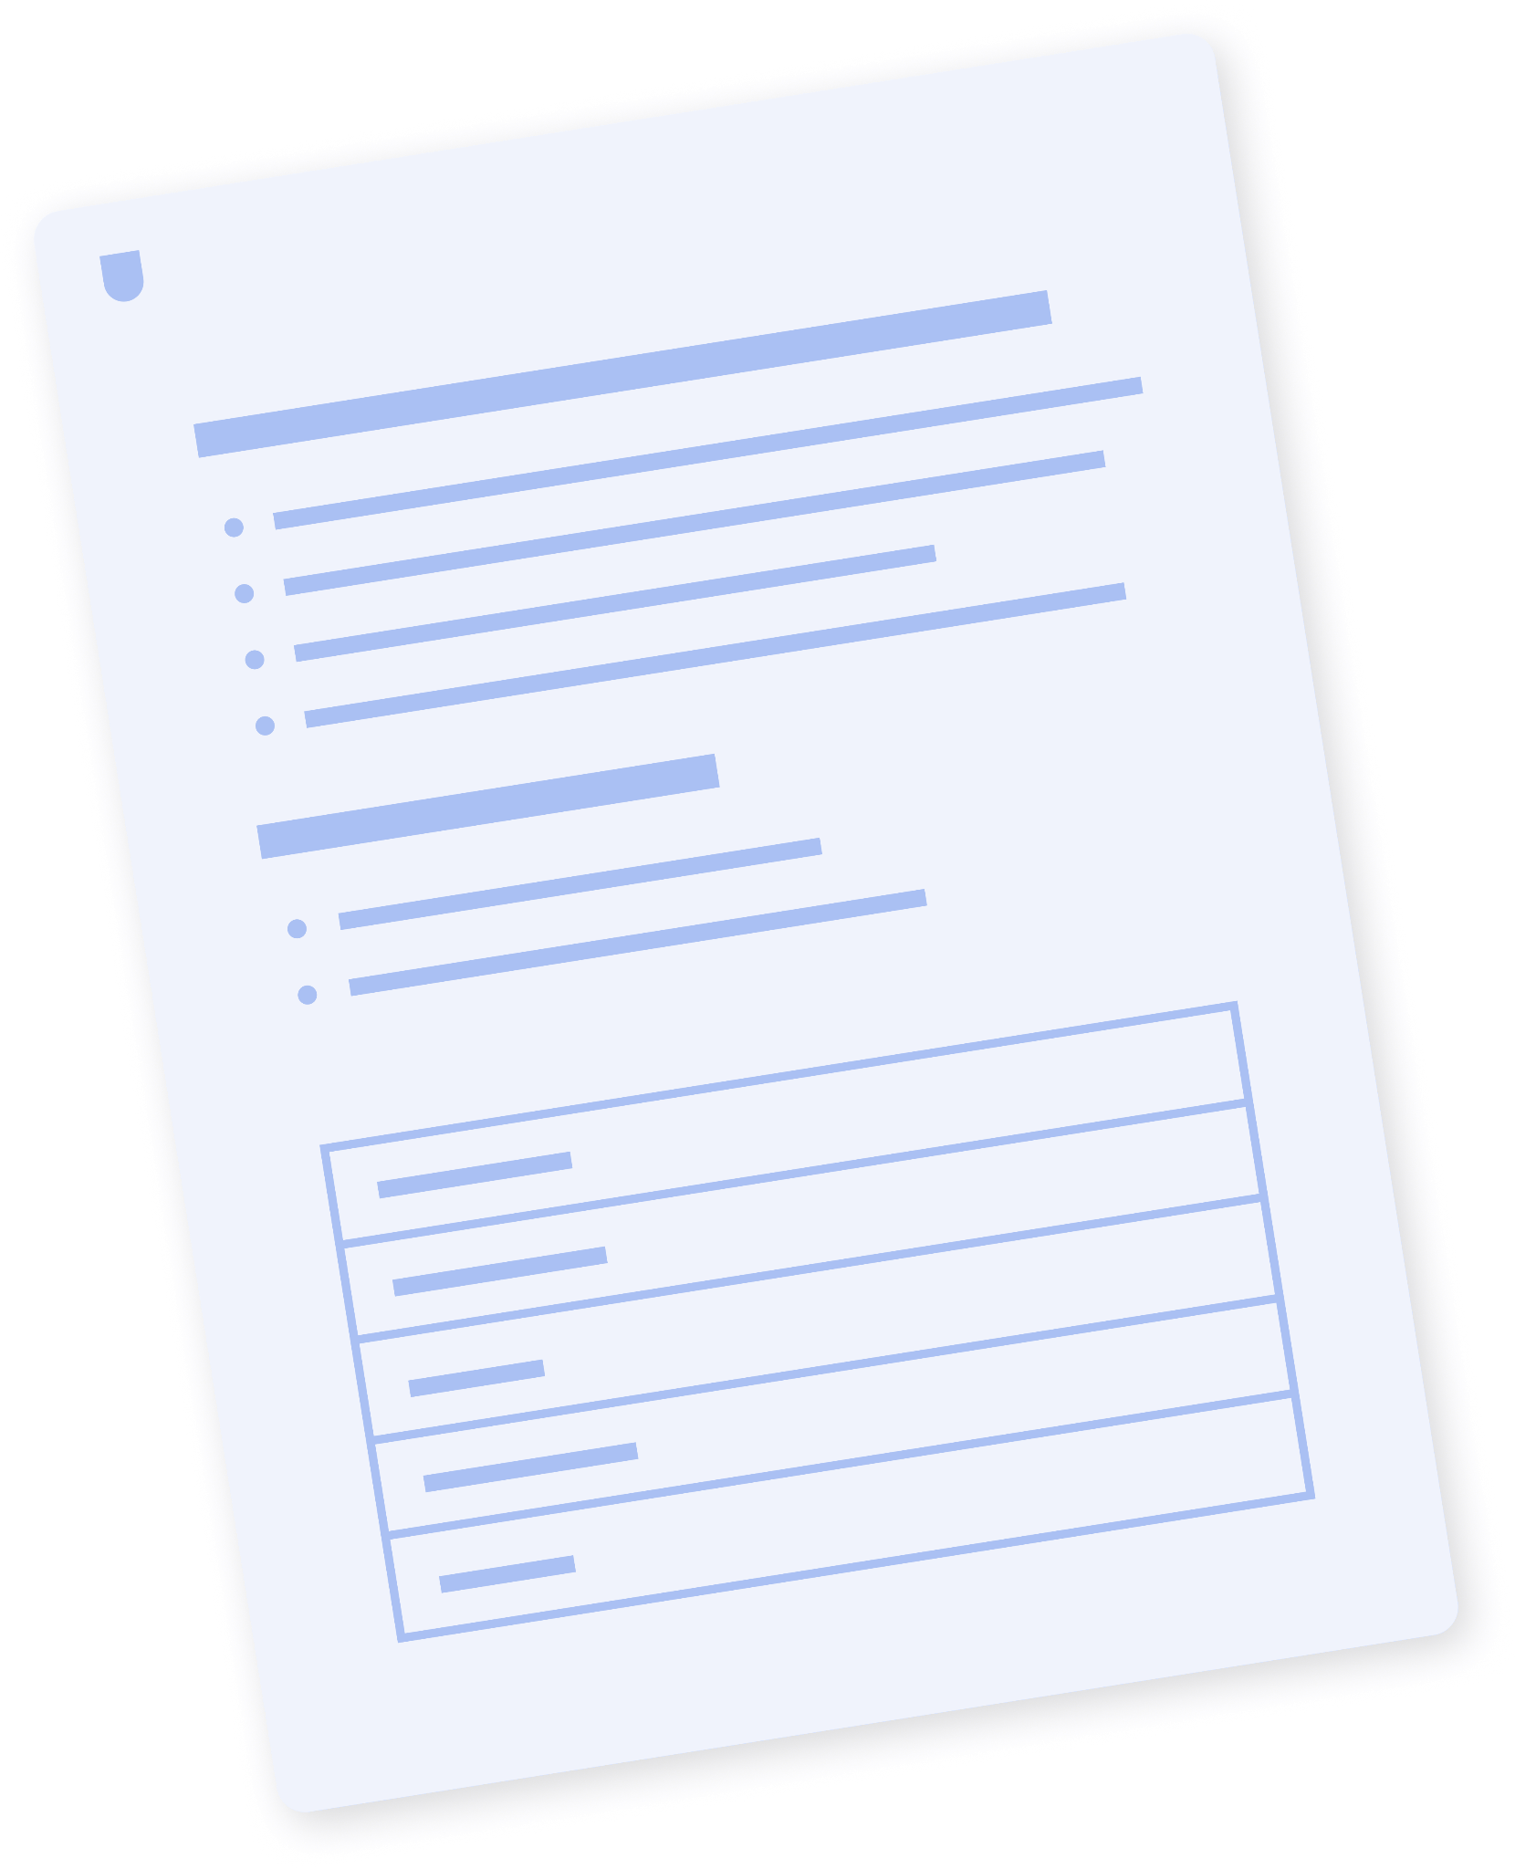
Resources & Templates
Bonus
HANDS-ON LAB WALKTHROUGH
PRODUCT SCHOOL TEMPLATE
Module 3 Lab Guide
Vibe Coding Prompt Techniques Template
View resource
View template
Notes:
🗂 More Resources
Here are some additional resources students can learn to deepen their knowledge of what we have covered in this section.

Slide 28
Q&A
Notes:
Notes
💥Activity: Q&A
This is a chance to dive deeper into the topics covered and answer any additional questions students may have!

Slide 29
Notes:
Thank you 💥

